Slide 1


The form reliever HOW we can help authorities to process forms during and after covid-19 crisis
Team #60 – Hackathon submission
5th of april 2020

Slide 2





Your Team #60
Our mission is to contribute to the swiss society during and after crisis by using each of our expertise in a targeted manner
Arlind Nocaj
«Extraction Guru»
Fabio Sulser
«Code Cookie»
Marco Maggiotti
«Solution Pioneer»
Mario Salecker
«Super Mario»
Priya Pimol
«Boss Baby»
AI/ML Architect at Accenture
PhD in computer science
«I love to bring AHA effect to people and clients by using the power of data and ML»
Tech Lead Data and Automation at KREATIZE (former Accenture)
Studied computer science
«I use this hackathon as an excuse for a reunion with my colleagues»
Solution Architect at Accenture
Software Engineer
«It’s not me that behave like Stitch, it’s Stitch that behave like me»
Solution Architect at Accenture
Studied computer science 20 years ago
«I’m here to save the world...or project»
IT Consultant at Accenture
Master in Business Administration
«I’m A-sian, not B-sian»

Slide 3


Content
WHY OUR PRODUCT IS NEEDED
WHAT IS THE FORM RELIEVER
WHO WILL USE IT
HOW THE FORM RELIEVER CAN BE USED

Slide 4


Executive Summary
Why the form reliever will make an impact to the Swiss society
OUR UNDERSTANDING
OUR IDEA
Significantly higher demand of authority work due to the COVID-19 crisis – but capacity is limited
Use our expertise in the field of OCR and data extraction and provide easy adaptable form reader
Relieve authorities by using innovative software solutions
Faster processing time for each request
Starting with the official COVID-19 pre-registration form for short-time work, then further expand to many other forms
Long-term solution that can also bring great value after the COVID-19 crisis
1
Swiss companies have already registered short-time work for more than 1 Mio. employees
2
Authorities have to deal among others with many different kind of forms and requests
3
Authorities process the incoming paper requests manually
4

Slide 5
Content
WHY OUR PRODUCT IS NEEDED
WHAT IS THE FORM RELIEVER
WHO WILL USE IT
HOW THE FORM RELIEVER CAN BE USED

Slide 6
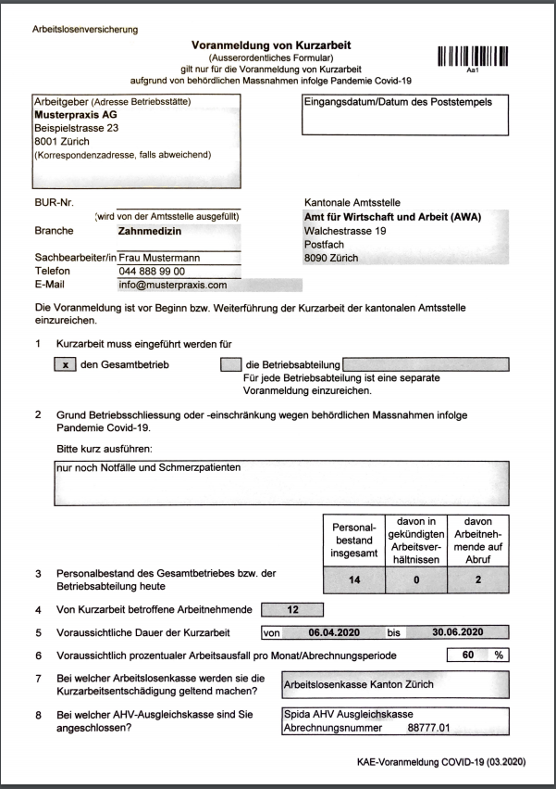
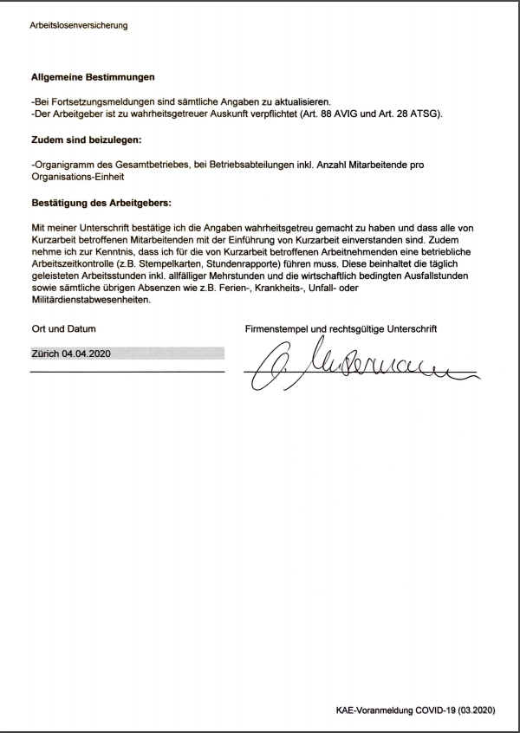



Demo: the form reliever the path to digitalization
Standardized pre-registration form for short-time work during COVID-19 crisis
Less manual effort (automated process)
Time saving & increased speed
Scalable to larger datasets & other forms

Slide 7
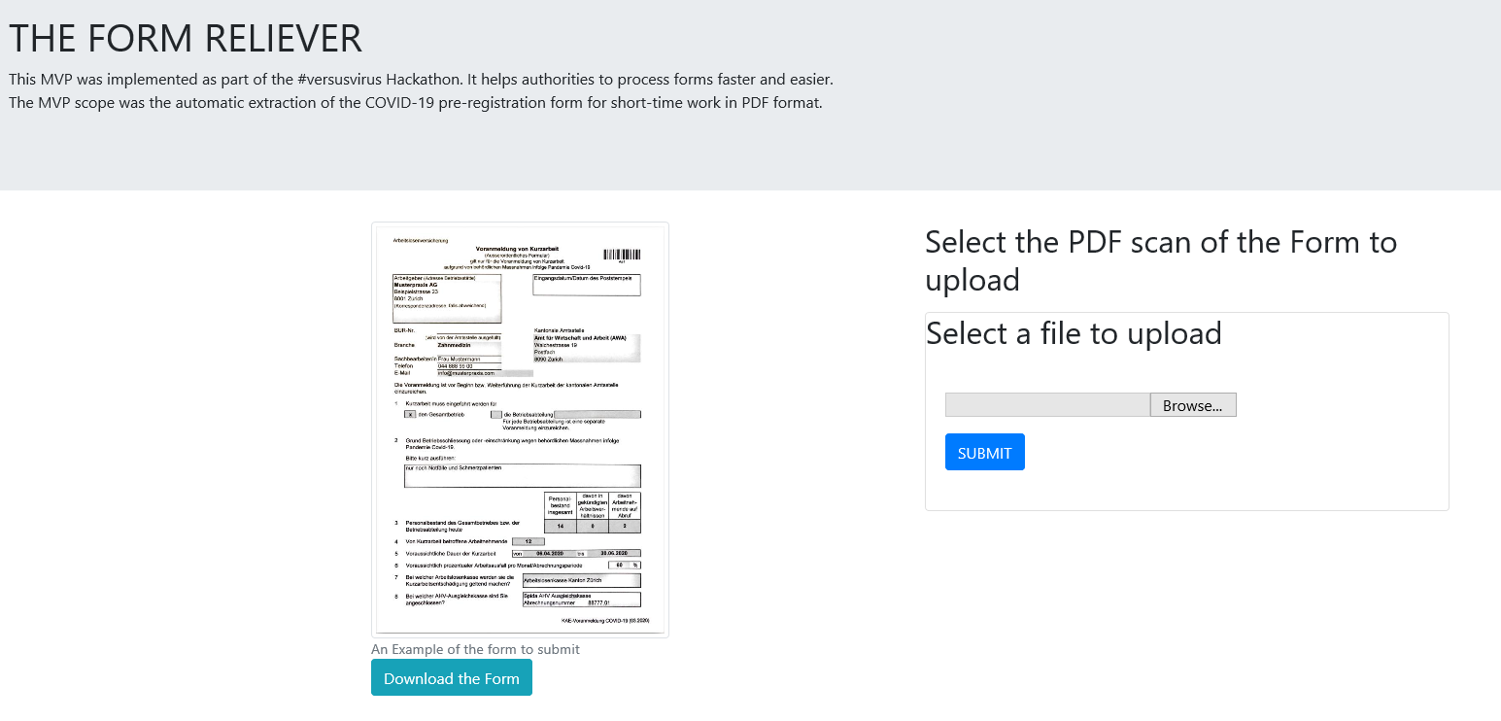
Demo: the form reliever Test our mvp yourself!
Link to our MVP tool:
http://doclux.net:8000/
Test files:
GitHub:
https://github.com/mariosalecker/vsvirus
(German)
(Italian)
(French)

Slide 8
Content
WHY OUR PRODUCT IS NEEDED
WHAT IS THE FORM RELIEVER
WHO WILL USE IT
HOW THE FORM RELIEVER CAN BE USED

Slide 9
Authorities are our primary target audience from communes via cantons to the federal government
«Relieve authorities with an easy adaptable form reader»
For authorities who deal with e.g. the following forms:
1
COVID-19 pre-registration for short-time work compensation (see DEMO)
2
COVID-19 Application and settlement of short-time work compensation
3
Application for unemployment insurance
4
Welfare claim
5
...and many more!

Slide 10
Content
WHY OUR PRODUCT IS NEEDED
WHAT IS THE FORM RELIEVER
WHO WILL USE IT
HOW THE FORM RELIEVER CAN BE USED

Slide 11

Easy adaptable tool with huge impact unused potential & OUTLOOK of the form reliever
UNUSED POTENTIAL
Scale to other incoming ad-hoc forms during crisis
Improve current MVP and quickly extend the extraction model to other important forms during the crisis:
Cantonal office: e.g. COVID-19 Application and settlement of short-time work compensation
Hospitals: e.g. COVID-19 test forms
Banks: e.g. COVID-19 loan requests
SBB: e.g. GA hand in
Extend to hand-written forms
Extend current MVP with the capability to recognize hand-written forms. Thus, many more forms can be processed automatically.
Enabler for full-stretch digital workflow for Swiss authority
We see great potential with our tool to bring Swiss authority one step closer to full-stretch digital workflow, where stakeholders do not have to submit paper-based forms anymore. Our solution can be integrated in an app or webpage.
Contactless workflow
Especially during the COVID-19 crisis, our solution can avoid physical contact between citizens and authorities (and all logistics between).
OUTLOOK

Slide 12
Using the power of data, opensource and algorithms to free up time for more relevant work in the society. We hope that we could contribute our part to the Swiss society!
- Team #60

